Slide 1


Lion Guide
and Parent Orientation
The Lion Pilot
The Boy Scouts of America’s pilot program
for kindergarten-age boys

Slide 2
Welcome
Welcome to the Lion orientation! If you are an experienced leader, relax—you will have this down in no time! If you are new to the program, come with us and enjoy learning about Lions!
Thank you for taking on the role of Lion guide. Your role is very important!
You will help kindergarten boys and families enjoy their first experience in Scouting.
You will be helping to create memories that will last a lifetime and be helping to build stronger families as they discover the fun of Scouting.

Slide 3
The Lion Pilot
Created by the Boy Scouts of America to address the needs of kindergarten-age boys
  Must be 5 years old by September 30, 2016, and not yet 7 years old to participate
Designed as an introduction to Cub Scouting
Should be implemented as the curriculum is written to ensure the validity of the pilot
Notes:
Your evaluation is needed to provide feedback for program continuation or expansion. To support the feedback, it is important to deliver the program as designed.
Reproduction or distribution without written consent is not authorized.

Slide 4
Overview
The Lion pilot program offers kindergarten-age boys and their adult partners an experience that includes:
  Fun while achieving Scouting’s desired outcomes
  Active and fast-paced excitement
  Hands-on exploration
  Values-based and relevant content
  Focused time together as a family

Slide 5

Scouting Is…
Scouting is designed to provide a fun adventure for boys that helps them “Be Prepared” for their future.
Scouting will:
  Build character
  Foster citizenship
  Develop personal fitness
  Develop leadership skills
  Participate in outdoor activities
  But the kids just want to have fun…
  Of course they do! Lions will be too caught up in fun to realize how much they’re growing.

Slide 6
Getting Started
Recruit Lion youth and leaders for fall 2016.
Adult partners complete the youth application and submit fees to the pack.
Lion guides complete the adult application and submit fees to the pack.
Lion guides complete the required Youth Protection training.
Youth Protection training is available free online
at www.scouting.org/training/youthprotection.aspx.
Although Youth Protection training is required only for Lion guides, it is suggested that all adult partners complete the training.
Notes:
On the youth application, just write in the word “Lion” at the top of the form.
Then when asked grade level write in “K’.
Because this is a pilot, the standard youth application will still be used. Changes to the form will not occur / nor will a reprint be done. Your normal application will work just fine.

Slide 7
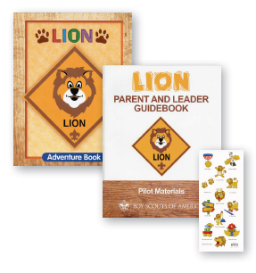
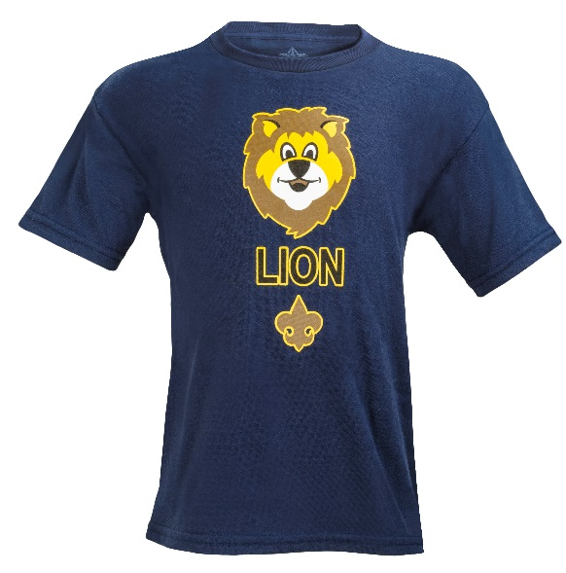

What Do You Need to Start?
You’ll need the program materials kit
(Lion Parent and Leader Guidebook,
Lion Adventure Book, and stickers).
The youth Lion Adventure Book is
designed as a memory or keepsake book.
The uniform is a Lion T-shirt and an
optional cap.
Adults are encouraged to wear a
Cub Scout activity shirt or Lion polo shirt,
or follow the pack’s uniform custom.

Slide 8
Basic Structure
Dens of six to eight boys, plus adult partners
Two den meetings per month
  Den meeting
    Usually lasts about 45 minutes
  Outing
    Field trips with the entire family
    Participation in two to three pack meetings

Slide 9
Lion Guides Set the Example
Get started on the right foot.
  Help families agree to a meeting location and time.
  Plan and prepare for the initial den meeting.
  Show the families a well-run den meeting.
  Have each adult partner sign up for a turn leading a den meeting and outing during the year.

Slide 10
Shared Leadership
Lion guide (an experienced den leader)
Oversees the den
Communicates with participating families
Leads initial den meetings and outings
Mentors adult partners as they lead den meetings and outings during the year
Integrates with the pack and pack leadership

Slide 11
Shared Leadership, continued
Adult partner
Participates with Lion in all meetings and outings
Takes turns leading a den meeting and outing, which is important for several reasons:
          1) It shows you leading, and your son will be proud of you.
2) Leadership is easier when everyone takes a small part.
3) It’s fun to be a part of contributing to the den’s success.

Slide 12
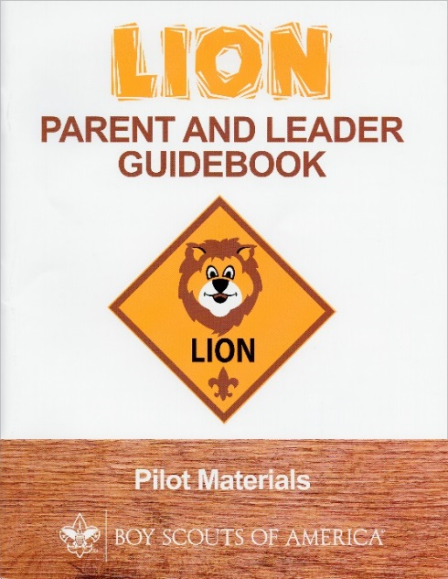
Leading a Den Meeting
Everything you need to lead the den meeting or outing is in the Lion Parent and Leader Guidebook.
  Preparation
  Gathering
  Opening
  Talk time
  Activities
  Closing
  After the meeting
  We’ve made it easy—it’s all here!
  Just follow this guide and you’ll be fine.

Slide 13
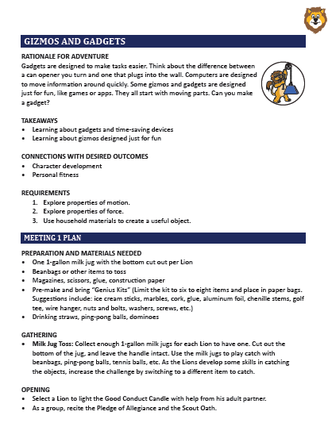


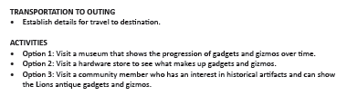
Take a Look Inside the Guidebook
Everything you need is here.

Slide 14
Adventures
Enjoy the program, have fun, and engage all families.
Required Adventures | Elective Adventures
Lion’s Honor (First meeting) | I’ll Do It Myself
Fun on the Run! | Pick My Path
Animal Kingdom | Gizmos and Gadgets
Mountain Lion | On Your Mark
King of the Jungle | Build It Up, Knock It Down
 | Rumble in the Jungle
 | Ready, Set, Grow
The timing for completing adventures is at the discretion of the den.

Slide 15
Remember Your Audience…
  Kindergartners bring many great attributes to your den. They are eager to learn, with high energy and very short attention spans. It’s a time of wonder and curiosity.
  In your den meetings and outings, remember that kindergartners haven’t yet mastered sitting still for long periods.
  To help Lions focus for success, have active time ready to go at a moment’s notice. Have them do jumping jacks or stretches with their arms reaching up to the ceiling.
  If they are having a hard time listening or engaging, STOP what you are doing and try one of these to get back on track.
    Try some fun or active elements between talk time and activities. Activity will help Lions refocus their energy and be ready to listen and participate.
    Be creative, ask them questions, and have fun!

Slide 16


Recognition
Lions are recognized for each completed adventure with a sticker for their Lion Adventure Book.
  No advancement report is required.
  Stickers come with each Lion program kit.
  Award stickers immediately.
The Lion badge is earned by completing five required adventures.
  The badge may be attached to the Lion cap or T-shirt.
Adventures are completed during the den meetings and outings.

Slide 17
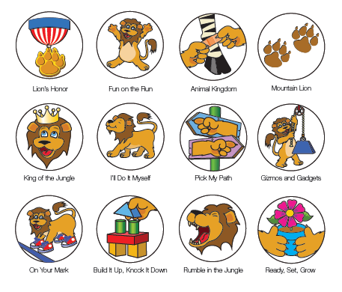
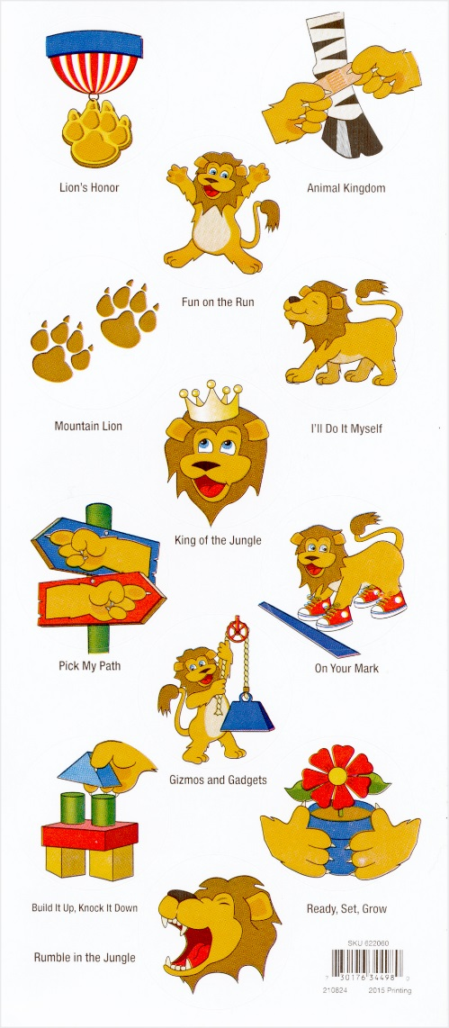
Adventure Stickers
Located inside your Lion program kit as shown here:

Slide 18
Pack Participation
Dens from other grades hold their own den meetings.
Once each month, all dens in a pack get together for a pack meeting led by the Cubmaster.
Lions are a part of the pack, at an introductory level.
Lions attend two to three pack meetings. When selecting pack meetings, consider these ideas:
  Pick a few really special or fun pack meetings, and make sure the Lions feel included.
  You may want to consider a holiday pack meeting, blue and gold banquet, or end-of-year celebration.

Slide 19
Training
Youth Protection training
  Required for Lion guides
  Available free online at www.scouting.org/training/youthprotection
Although Youth Protection training is required only for Lion guides, it is suggested that all adult partners complete the training.
Lion Guide and Parent Orientation video (2 minutes)
  Required for both Lion guides and adult partners
Lion Guide and Parent Orientation slide presentation
  Required for Lion guides
  Recommended and encouraged for each adult partner

Slide 20
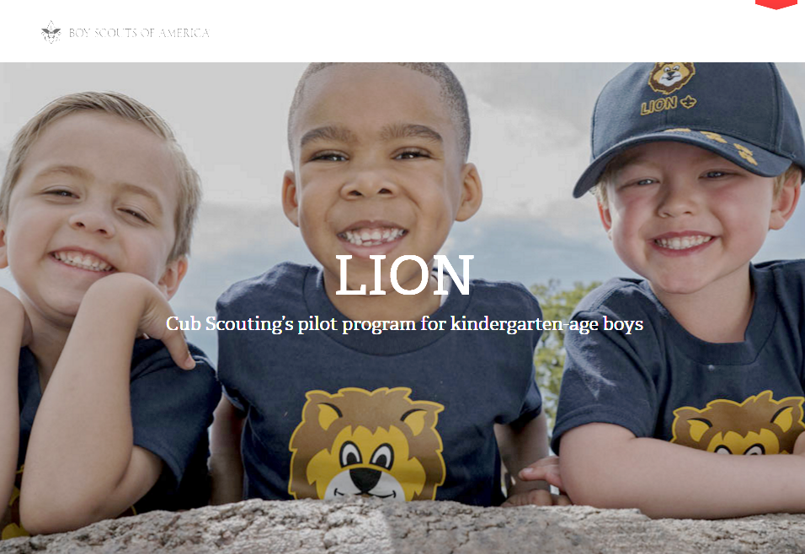
Online Resource
Lion web page: www.scouting.org/lion
One-stop shop for parent and leader resources
FAQs
Program overview
Lion Guide and Parent Orientation video
Lion Guide and Parent Orientation slide presentation
Recruiting materials—fliers, promotional video, photos, etc.
Need help?
Contact Member Care at 972-580-2489
or MyScouting@Scouting.org

Slide 21
Pilot Evaluation
The pilot program will be assessed and evaluated throughout the year.
Feedback will be requested from:
  Parents
  Lion guides
  Cubmasters
  Councils
For the pilot to be valid, it is important to deliver the curriculum and program as written.

Slide 22
Appendix

Slide 23


Lion vs. Tiger: Similarities
ADULTS:
LEADERSHIP:
RECOGNITION:
UNIFORM:
OATH and LAW:
CAMPING:
FUN:
LION
Adult partners required
Shared leadership
Stickers and Lion badge
T-shirt and optional cap
Scout Oath and Scout Law
Family camping with pack /
No den camping
ACTIVE and HANDS-ON!
TIGER
Adult partners required
Shared leadership
Adventure loops and Tiger badge
Cub Scout field uniform
Scout Oath and Scout Law
Family camping with pack /
No den camping
ACTIVE and HANDS-ON!

Slide 24
Lion vs. Tiger: Differences
BOBCAT:
DEN MEETINGS:
PACK MEETINGS:
FUNDRAISING:
DAY CAMP:
LION
Does not earn Bobcat
1–2 times per month
Attends a few (2–3)
Does not fundraise
No day camp
(until Tiger)
TIGER
Earns Bobcat
3–4 times per month
Attends all
Participates in fundraising
Tiger/Cub Scout day camp

Slide 25
Activation Timeline
May – Aug. Recruit and train Lion guides
Aug. – Sept. Recruit youth, Lion pilot begins
May 2017 Surveys, evaluations, and select focus groups conducted by the Pilots and Program Development Department

